Slide 1

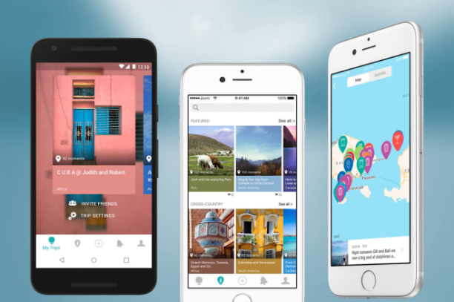


MEMORI
What is Memori?
Memori is a travel journal app designed to keep your treasured memories safe. You’ll no longer store everything about your holiday in several places, as Memori will sort it for your from the comfort of your own hands!
Memori can keep all of your holiday memories in a safe and in a reliable place, which you can access anywhere in the world. It could even tell you what to visit next on your journey. All this will be grouped in a single holiday, making it easier for you to track when you get home. And just in case you lose your phone, all the data is backed up to the cloud.
What can Memori do?
There are plenty of reasons why Memori should be the next app you download. These include a simple and easy to use UI with a whole list of features. A new coveted feature found in apps called Dark Mode. A whole new way to share your adventurous holidays through a social media service where users can view others’ holidays. And many more!
What makes Memori better thank its rivals?
IMAGE?
BY BHAVEN PATEL
Memori will be the next ground-breaking app that everyone will talk about when travelling. Many of the current alternatives do not provide such a wide array of services, which is why I believe this app will be the first of its kind. Memori will revolutionize the way holidays are kept and shared!
Why choose Memori?
Notes:
Image References:
Travel Image: https://disabilityhorizons.com/2017/06/all-clear-travel-insurance-2/
App Image: https://techcrunch.com/2016/08/23/journi/
Cloud Image: https://www.emhtechnology.com/the-business-benefits-of-cloud-storage/
Dark/Light Mode Image: Self-Designed

